Slide 1
Variational inference
Using factorized approximations
Part 2
Weiji Ma, 20140515

Slide 2
Last week
1. Deriving the magic equation
2. Worked example 1: Gaussian

Slide 3
Observations X
World state Z
Generative model p(X,Z)
Posterior p(Z|X)
Motivation: nasty posterior, compute expectations
Approximate using a more pleasant distribution q(Z)
Factorized approximation:
Magic equation:
Functional forms of components q_{i}(Z_{i}) fall out!

Slide 4
Worked example 1: Gaussian
Set of observations X₁,…,X_{N} , independently drawn from a normal:
Want to compute a posterior over mean μ and precision τ
Factorized variational approximation:
Magic equation:

Slide 5
q_{μ} is normal with mean and variance
q_{τ} is gamma with shape and rate
Iterative process:
Start with try for
Now compute using q_{μ} and
Then recompute using q_{τ} and
Converges very fast!

Slide 7
Process of variational inference
Closed-form expression for log p(X,Z)
Apply magic equation for factorized variational approximations → q_{i}(Z_{i}) in terms of each other’s parameters
Solve directly or iterate to compute each individual q_{i}(Z_{i})

Slide 8
Today
1. Deriving the magic equation
2. Worked example 1: Gaussian
3. Worked example 2: Categorization
4. Relation to population codes

Slide 9
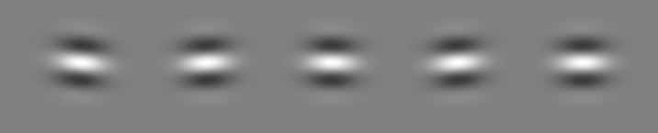
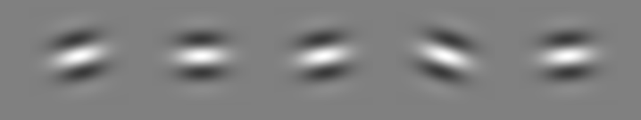
Worked example 2: Categorization
σ₀=3º
σ₁=12º
Examples of Category 0 stimuli
Category 0
Category 1
Probability
Examples of Category 1 stimuli
-40
-20
0
20
40
Orientation (°)
Qamar et al., 2013

Slide 10


Slide 11
We vary contrast.
The observer makes a noisy measurement x.
C
C=0,1
s
s is a real number
x
x is a real number

Slide 12
Observation x
World states C, s
Generative model p(x,s,C)
Posterior p(s,C|x)
Although the observer is only asked to report C, let’s see how well we can approximate the joint posterior p(s,C|x)
Let’s first calculate the exact joint posterior

Slide 13
C
s
x
Not factorizable!

Slide 17
Let’s start the variational inference.
What factorization assumption will we make?
Write out the magic equation:

Slide 18
Use the magic equation to find q_{C}(C) and q_{s}(s).
Possibly helpful:

Slide 19
q_{C}(C) is Bernoulli with mean
q_{s}(s) is Gaussian with mean
and second moment

Slide 20
x = 11.2 Variational approximation iteration 10
Joint posterior
Marginal over s
Marginal over C
x 10
-3
7
1
C=0
6
0.8
C=1
5
Posterior
4
0.6
3
0.4
2
1
0.2
-20
-10
0
10
20
0
0
-30
-20
-10
0
10
20
30
0
1
Orientation
Orientation
Category
0.6
1
0.5
10
0.8
0.4
9
0.6
KL(q||p)
mean of q_{s}
mean of q_{C}
0.3
0.4
8
0.2
0.2
0.1
1
2
3
4
5
6
7
8
9
10
7
1
2
3
4
5
6
7
8
9
10
0
1
2
3
4
5
6
7
8
9
10
iteration
iteration
iteration

Slide 22
From iterative estimation to a dynamical system
q_{C}(C) is Bernoulli with mean
q_{s}(s) is Gaussian with mean
and variance
Iterative estimation
Dynamical system

Slide 23

category
orientation
“PFC”
“V1”
Goals:
Optimal posterior in “PFC” on each trial regardless of quality of input
Same form of neural code in “V1” and “PFC”
Plausible neural operations between “V1” and “PFC”

